Slide 1
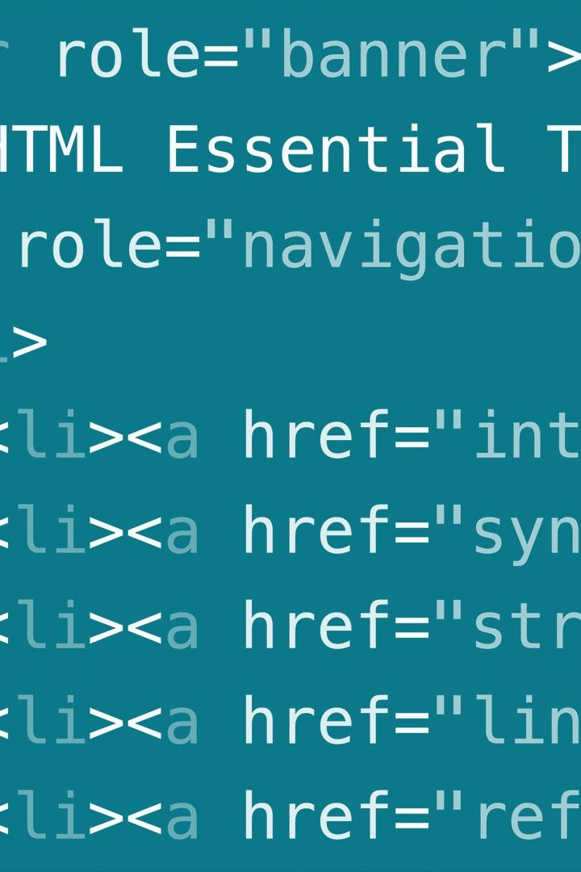
HTML Basics: Basics You Need to Know
Welcome to our beginner's guide to HTML! In this presentation, you'll learn the fundamentals of HTML and how it all works.

Slide 2



What is HTML?
The Internet
Markup Language
Programming Language
HTML is the backbone of the internet, the standard markup language used to create web pages.
HTML uses a set of markup tags to describe the content within a webpage.
HTML isn't a programming language, rather a language for organizing and formatting content for display on the web.

Slide 3

The Importance of Learning HTML
In-Demand Skill
Easy and Quick
Customization
As technology continues to grow, so does the need for web developers with HTML knowledge.
HTML is quick to pick up and easy to use, and it's the foundation of all web-related languages and technologies.
HTML is an essential tool in customizing, designing, and integrating web pages with other tools and technologies.

Slide 4
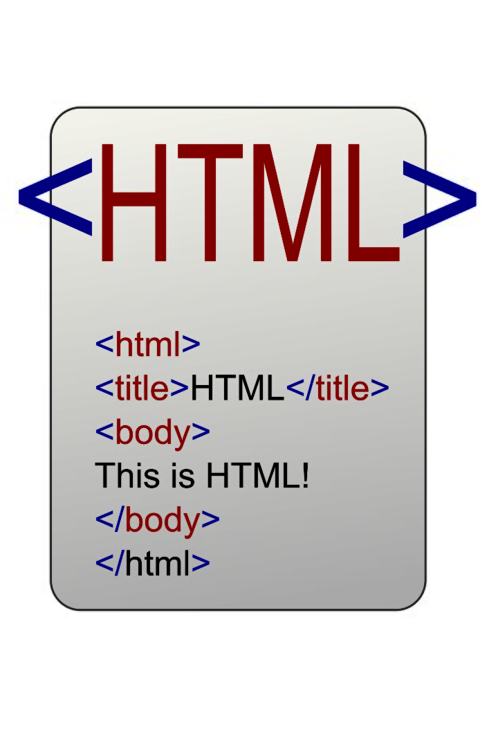
HTML Tags
HTML tags are the building blocks of a webpage. They define the structure and content of different elements on the page. From headings and paragraphs to links and images, HTML tags provide the necessary structure and meaning to your content. Understanding the different HTML tags is essential for creating well-structured and accessible webpages.
Mostly the tags contain both the opening and closing tags like <head>..</head>.
But there are tags that does not contain a closing tag <br>,<img> etc.

Slide 5
HTML Document Structure
1
Head Section <Head> </Head>
This section contains metadata about the page, such as the title and other important information.
Body Section <Body> </Body>
2
This is where all the content, images, and text of the website are placed.
3
Title Tag <Title> </Title>
The title tag appears in the browser's tab, and it defines the title of the document. It should be concise and relevant to the content.

Slide 6
HTML Elements
1
Text Formatting
HTML allows for easy text formatting using tags like <h1></h1> for headers and <p> </p> for paragraphs.
Hyperlinks
2
HTML makes it easy to add links to your webpage, allowing users to navigate your site and find other resources online. We use an anchor tag <a> </a> .
3
Images
Adding images to your webpage is made easy with HTML, just add the <img> tag and choose the image file to upload.

Slide 7
Conclusion and Resources
Recap of Key Points
Additional Resources for Learning HTML
HTML is the backbone of every web page.
HTML is easy to learn and use.
W3Schools
HTML is essential for customization and design.
MDN Web Docs
Codecademy
HTML offers many ways to organize and format your content.

